Slide 1

CLASS 12 : Functions in JavaScript

Slide 2
Introduction: What are functions
Functions: are reusable blocks of code that perform a specific task. They help you avoid repeating code and make your programs more organized.
Analogy: Think of a function like a recipe - you write it once, and then you can "cook" (execute) it whenever you need that specific dish (result)
Why Use Functions?
- Reusability: Write once, use many times
- Organization: Break complex problems into smaller pieces
- Maintainability: Fix bugs in one place instead of many
- Readability: Descriptive function names make code easier to understand

Slide 3
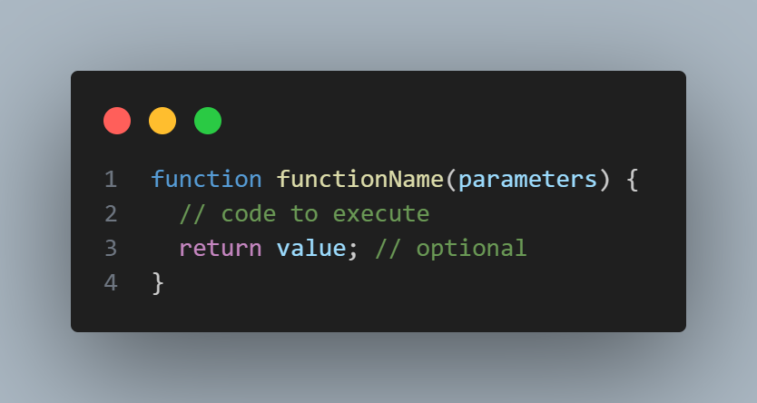
Part 1: Function Declarations
Basic Function Syntax

Slide 4
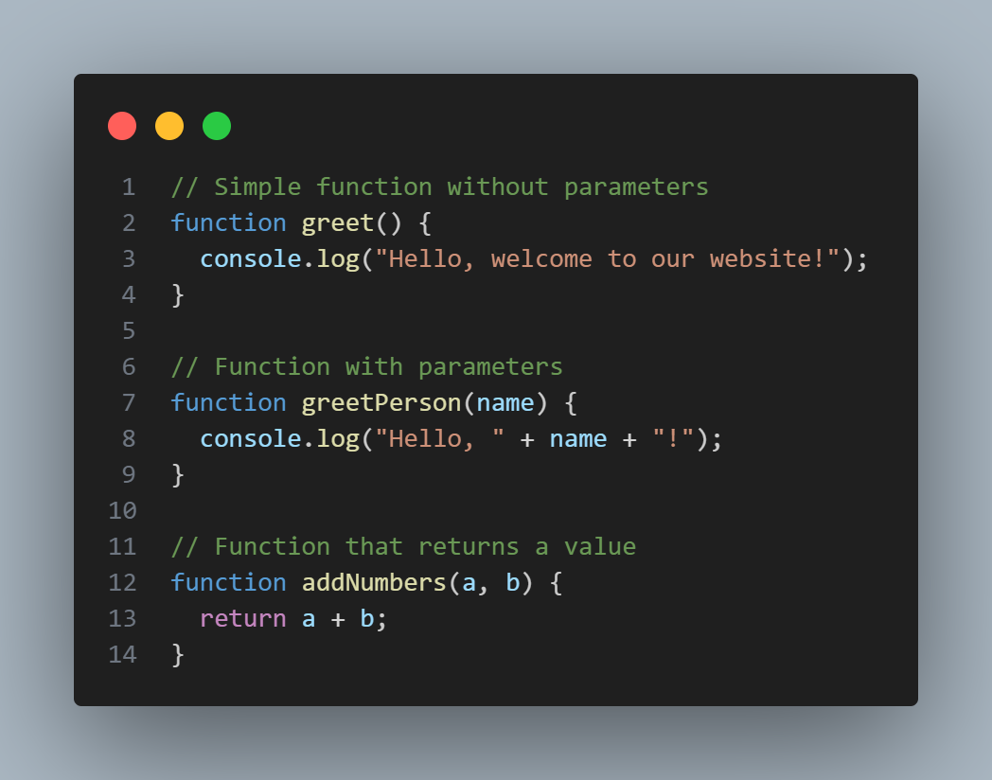
Examples

Slide 5
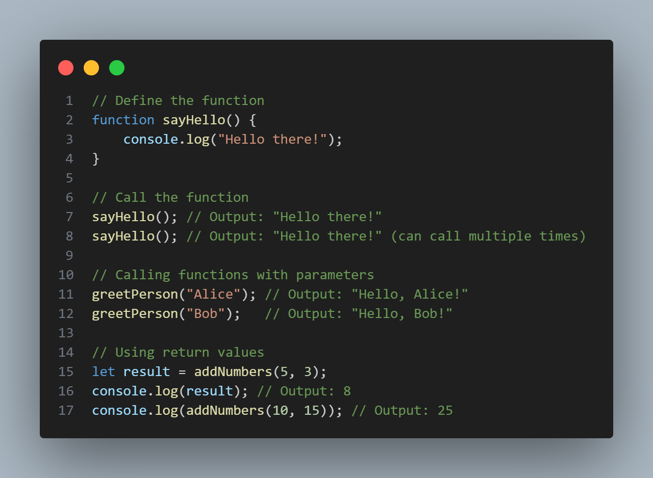
Part 1 cont’d
Calling (Invoking) Functions
To use a function, you must call it by using its name followed by parentheses:

Slide 6
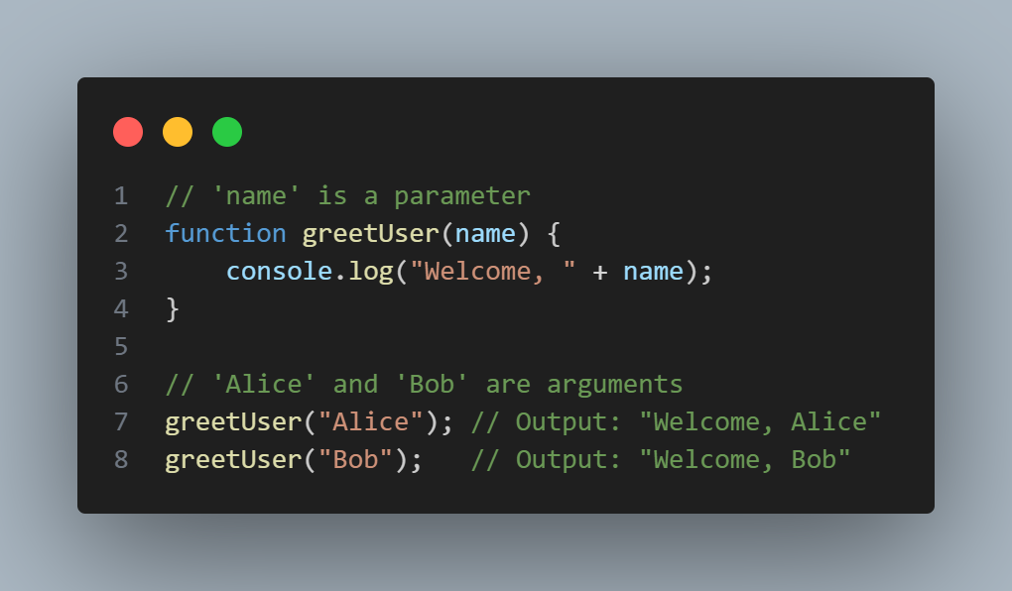
Part 2: Parameters and Argument
Parameters: Variables listed in the function definition
Arguments: Actual values passed to the function when called

Slide 7
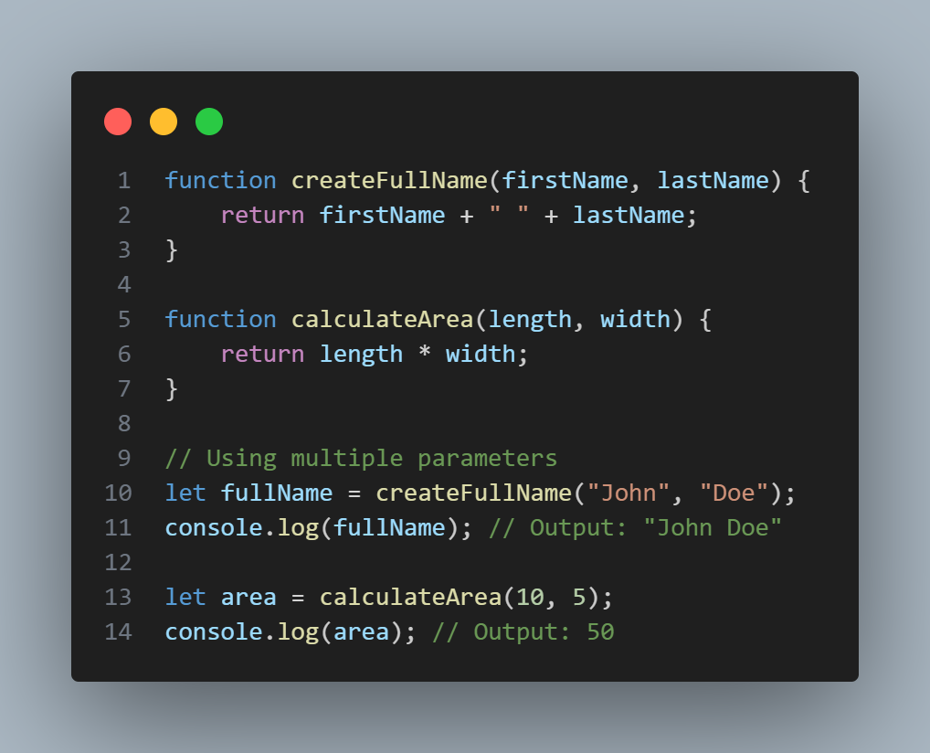
Part 2 cont’d
Multiple Parameters

Slide 8
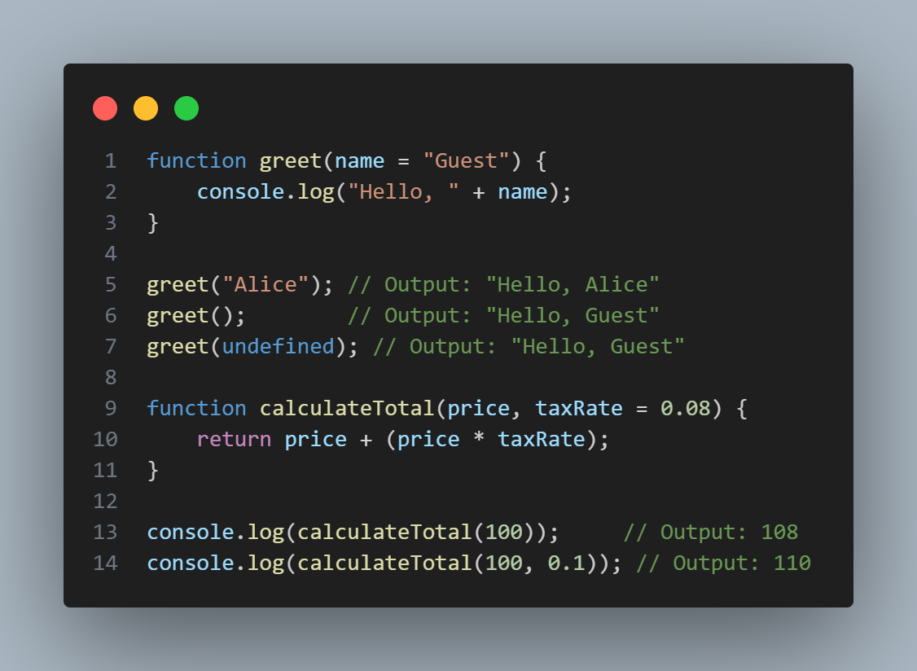
Part 2 cont’d
Default Parameters

Slide 9
Part 3: Return Values
The “return” Statement
The ‘return’ statement sends a value back from the function
Functions without ‘return’ return undefined
‘return’ immediately exits the function

Slide 10
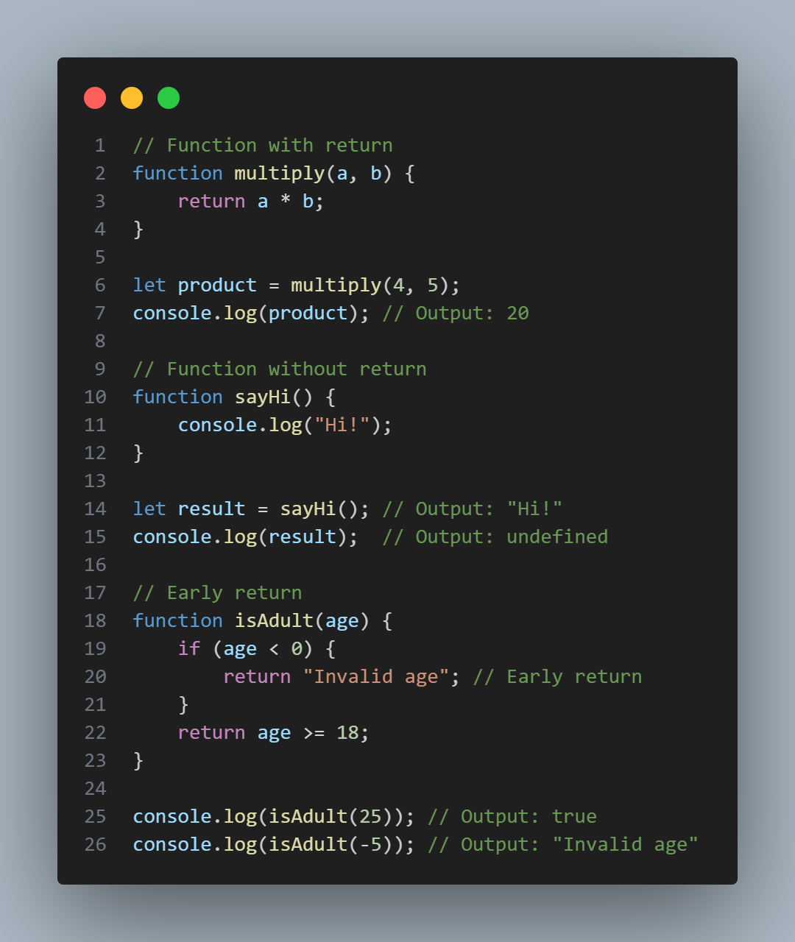
Examples

Slide 11
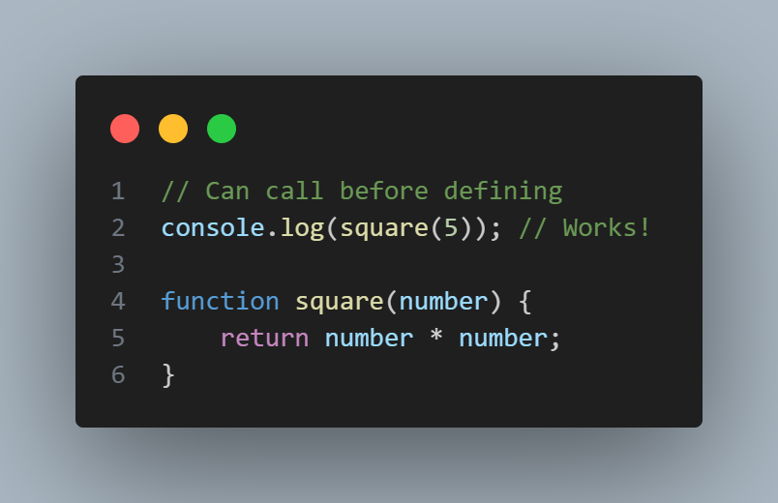
Part 4: Function Expressions
Function Expression vs Declaration
Function Declaration: (Hoisted - can be called before definition)

Slide 12
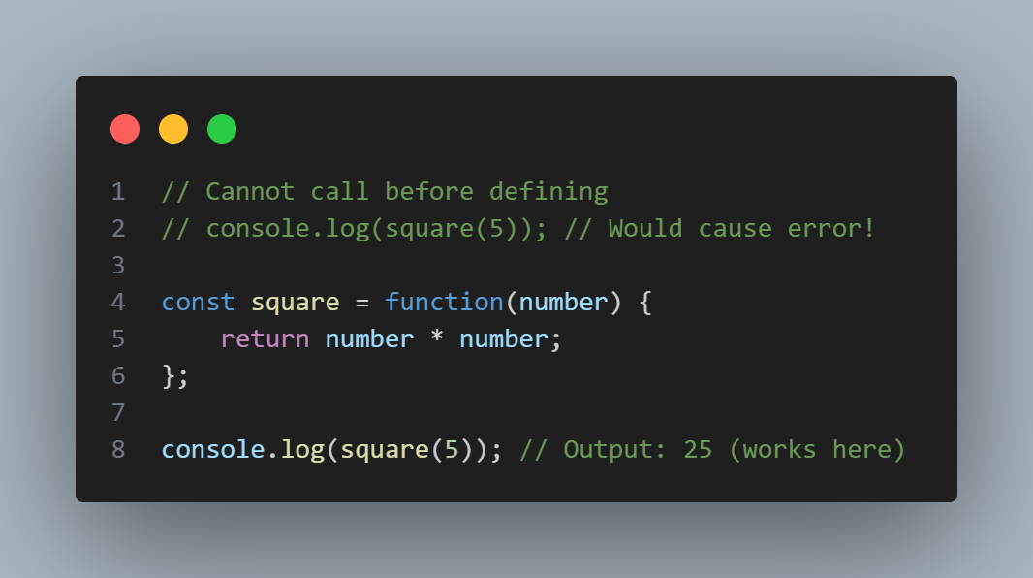
Part 4: Function Expressions
Function Expression vs Declaration
Function Expression: (Not hoisted - must be defined before calling)

Slide 13
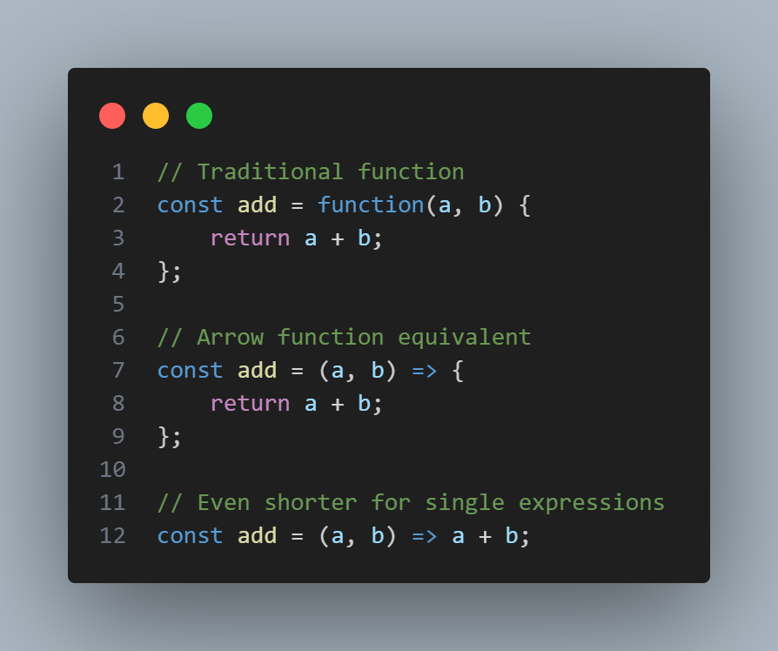
Part 5: Arrow Functions (ES6)
Arrow Function Syntax
A shorter syntax for writing functions:

Slide 14
Part 5: Arrow Functions (ES6)
When to Use Arrow Functions
Great for:
Short callback functions
Array methods (map, filter, etc.)
Simple one-liner functions

Slide 15
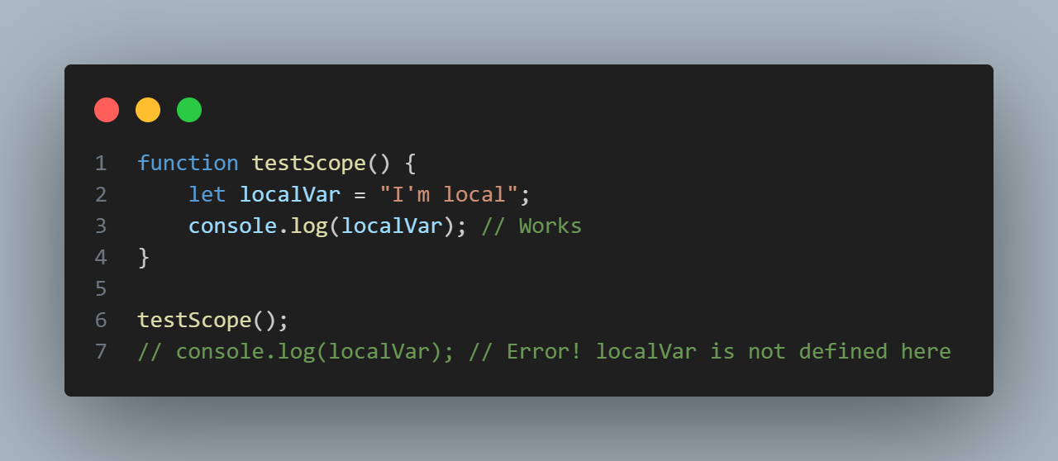
Function Scope
Variables defined inside a function are not accessible outside:

